Slide 1

Shaping Student Behaviors
Module 6

Slide 2
Topics to be Covered in this Presentation
Shaping student behavior
Individual behavior change
Teaching self-monitoring strategies

Slide 3
As discussed throughout this course, it is the teacher’s job to create a safe and welcoming environment in the classroom, one in which all students feel free to learn and express themselves.
As was also discussed throughout this course, teachers must be proactive in dealing with students who, for one reason or another, are disruptive to the learning environment.

Slide 4
In the first presentation here in Module 6, you learned that there are two reasons for a student’s actions . . . either to get something or to avoid something, and it is the purpose of the functional behavioral assessment or FBA to determine what that motivation actually is for a particular student. It is in the behavioral intervention plan or BIP that alternate behaviors are explored.

Slide 5
Another method of altering student behavior is somewhat controversial, but it is grounded in theory. In this presentation, let’s look at ways of shaping a student’s behavior to better allow the student to learn in the classroom.

Slide 6
Shaping Student Behavior

Slide 7
What is Shaping?
A teaching technique that involves a teacher rewarding a child as he/she successfully improves the acquisition of a target skill
Also known as successive approximation
Considered an essential process in teaching because a behavior cannot be rewarded unless it first occurs
  Shaping is intended to lead children in the direction of an appropriate complex behavior, and then reward them as they complete each successive step
What theory does this spring from?

Slide 8
Historical Origins
It arose from behaviorism, a field of psychology established by B.F. Skinner and based on the relationship between behaviors and their reinforcement
Skinner believed that behaviors need to be reinforced by specific preferred items or food
Behaviorism and behavioral theories are the foundations of applied behavior analysis (ABA), which is used successfully with children who fall somewhere on the autistic spectrum among others
Although often considered "mechanistic," ABA has the advantage of allowing the therapist, teacher, or parent to take a dispassionate look at the specific behavior, rather than focus on a "moral" aspect of the behavior (as in "Robert should know that it's wrong!")
Not restricted for use with autistic children. Skinner himself used it to teach animals to perform tasks, and marketing professionals have used shaping to establish preferences in a customer's shopping behaviors

Slide 9
Shaping Process
Teacher needs to identify a student's strengths and weaknesses around a specific skill, and then break the skill into a series of steps that lead the child toward that target
  Example #1:
    If the targeted skill is being able to write with a pencil, a child might have difficulty holding a pencil
    An appropriate beginning step may start with the teacher placing her hand over the child's hand, demonstrating to the child the correct pencil grasp
    Once the
  Example #2:
    If the targeted skill is the same as above, how would the step change if this student simply not interested in writing but who loves painting?
    Providing the student with a paint brush and rewarding the painting of a letter

Slide 10
Shaping Process (cont.)
May require a teacher to create a task analysis of the target skill in order to create a roadmap for shaping the behavior
In that case, it is also critical for the teacher to model the shaping protocol for classroom paras so that they know what approximations are successful and which approximations need to be cleared and retaught
Although this may seem like a painstaking and slow process, the step and reward process deeply embeds the behavior in the student's memory, so that he or she will be likely to repeat it

Slide 11
Examples
Maria used shaping to help Angelica learn to feed herself independently
  She helped Angelica use the spoon hand over hand
  She then moved to touching Angelica's wrist until Angelica was finally able to pick up her spoon and eat from her bowl independently
While teaching Robert to use the toilet independently to urinate, his mother, Susan, saw that he had difficulty pulling up his pants so she shaped that step in the task analysis
  She first praised and reinforced his ability to pull his pants up to his knees
  She then praised and reinforced his ability to stretch out the elastic waist to
  Lastly, she then helping Robert by using hand over hand to complete the "pulling up pants" step

Slide 12
Advantages of Shaping Behavior
A “hassle” in the classroom is removed
Moves you closer to acceptable behavior in the classroom
Target behavior can be achieved

Slide 13
Disadvantages of Shaping Behavior
Sometimes it may be difficult to consistently apply it
The reinforcement can be become predictable or no longer appealing to the child
It can be time consuming
It can be misapplied
It requires consistent monitoring
Progress is not always linear
Harmful behavior can be shaped

Slide 14

Let’s Look at a Video Providing a Light Look at Shaping!
Nilsson, S. (2009). Sheldon shaping Penny in Big Bang Theory. Retrieved from https://youtu.be/teLoNYvOf90

Slide 15
What Do You Think About Shaping Behaviors?

Slide 16
  individual behavior change

Slide 17
Behavioristic Interventions Are , , ,
Viewed by some as manipulative or overly repressive, and by others as a panacea
Are sometimes effective in helping students develop more responsible behavior
Based on three major assumptions:
  Behavior is influenced by antecedents and consequences
  Behavior change programs focus on specific, observable behavior
  Data collection is necessary to alter behavior thoughtfully and systematically

Slide 18
Benefits of Classroom Behavior Assessment
Provides teacher with objective view of student behavior (removes emotion that can influence interpretation)
Allows adults to examine how their own behavior may impact the student’s behavior
Utilizes data to inform decisions and actions
Relatively easy to conduct with minimal training/preparation
Can have significant positive impact on student behavior and class functioning

Slide 19
Here are just a few techniques and/or strategies that may make the job of any teacher much easier . . .

Slide 20
Self-Monitoring Procedures
Make sure students understand and can demonstrate the desired behavior
Develop a method for tallying the data; teach it to the student
Identify a relatively short time span (consider developmental appropriateness) in which to begin monitoring
Meet with the student to assess progress
Reinforce as appropriate
We will discuss this topic more in depth a little later

Slide 21
Social Skills Training
Is used when students demonstrate a lack of important social skills
Has been shown to be effective with students with a wide range of special needs
May be part of a school-wide plan, or provided in grade-level, class, small group, or individual formats
Often begins with a classroom behavior assessment to determine the specific skill(s) that need to be developed
Generally follows a specific series of steps

Slide 22
Elements of Social Skills Training
Helps student identify the ineffective behavior
Helps student identify the reason for changing the behavior
Describes the desired behavior
Specifies in detail the components of the desired behavior
Adult modeling of the desired behavior
Student practice of the desired behavior
Independent practice opportunity in context
Individual or group reinforcement strategy

Slide 23
On the following few slides you will see examples of a few videos that may be useful for social skills training. If you plan to teach social skills, just search the internet and you will find videos for most of the social skills conditions you wish to cover.

Slide 24
Resolving Disagreements
TD Social Skills. (2012). Social skills training: Resolving disagreements. Retrieved from https://youtu.be/DvSk5T_0UfU

Slide 25
Making Friends in Middle School
TD Social Skills. (2012). Social skills training: Making friends in middle school. Retrieved from https://youtu.be/MJYLfekgw2I

Slide 26
Asking a Friend to Play
Harrah, M. (2015). Video modeling – Asking a friend to play. Retrieved from https://youtu.be/sBPyVl3S5-k

Slide 27
Behavior Contracts
Are agreements between two or more parties indicating the manner in which one or more of the parties will behave in a given situation
Are often written, specifying the behavior(s) each individual will display and the reinforcement or consequence associated with fulfilling or failing to fulfill the contract
Provide students with structure and a specific concrete “payoff” for demonstrating the desired behavior

Slide 28
The next few slides provide examples of various behavior contracts.

Slide 29
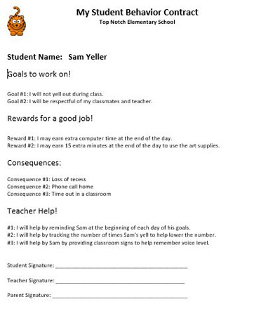
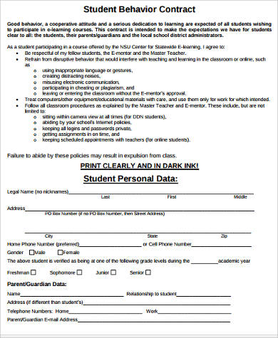

Slide 30
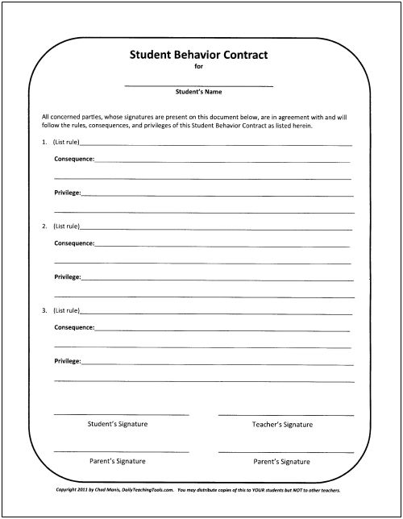
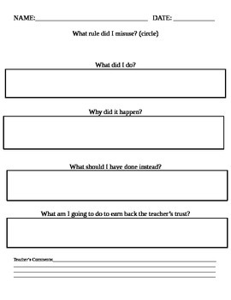

Slide 31
An Effective Contract Includes Statements About . . .
The contract’s goal/why it has been developed
The specific behaviors the student must perform to receive reinforcement/avoid consequences
The reinforcers or consequences that will be employed
The time dimensions
Who will monitor the behavior and how they will do so
How often and with whom the contract will be evaluated

Slide 32
When Selecting Reinforcement/Consequences
Start with the least restrictive and most natural ones
Try in this order:
  Social reinforcement
  Activity reinforcement
  Social, token, and activity reinforcement
  Curtailment of activity
  Social, token, and activity reinforcement and response cost
  Tangible reinforcement

Slide 33
Teaching self-management strategies

Slide 34
Teaching Self-Monitoring Strategies to Students
Self-monitoring is an effective tool for behavior change in students
There are 2 components:
  Measurement – student measures and records his/her own behavior
  Evaluation – student compared measured behavior to a pre-determined standard
Self-monitoring can take many forms
  A paper form to rate study skills at the end of each class period
  Verbally rate social behaviors when approached by his teacher at random times across the school day
Based on a behavioral principle: measuring one's target behavior and comparing it to an external standard/goal can result in lasting improvements to that behavior
Sometimes described as having 'reactive' effects because students who measure and pay close attention to selected behaviors often react to this monitoring information by changing those target behaviors in the desired direction

Slide 35
Advantages of Self-Monitoring in the Classroom
Requires that the student be an active participant in the intervention, with responsibility for measuring and evaluating his or her behaviors
In order to accurately self-evaluate behaviors, the student must first learn the teacher's behavioral expectations
  That ability of the student to understand and internalize the behavioral expectations of others is a milestone in the development of social skills
Student self-monitoring data is typically economical to collect, even in a busy classroom, and can often be used to document the success of a behavioral intervention

Slide 36
Effective Student Self-Monitoring Plans Usually Include the Following 7 Steps . . .

Slide 37
Defining Target Behavior
Choosing Method to Record Data
Determining Self-Monitoring Schedule
Self-Monitoring
Determining a Monitoring Tool
Choosing a
Reward for Successful Behavior Change
Fading the Self-Monitoring Plan
Conducting Periodic Accuracy Checks

Slide 38
Defining Target Behavior
Self Monitoring

Slide 39
#1 - Defining Behavior Target(s) to Self-Monitor
Collaboratively, the student and teacher select and carefully define the behavior(s) for the student to monitor
These can include behaviors to increase
  Remaining on-task
  Making positive comments to peers
  Completing work assigned
  Complying with teacher requests
  Reading pages of text in a timely manner
  Completing math computation problems
These can also include behavior to decrease
  Calling out in class
  Not remaining seated during class
  Repeatedly requesting teacher assistance

Slide 40
#1 - Defining Behavior Target(s) to Self-Monitor (cont.)
Student and teacher should meet privately to what to monitor
For each goal behavior, they will write a clear, specific behavioral definition that provides observable 'look- fors' to indicate when the behavior is displayed
  For example, “on-task” can be made observable by defining it as "eyes on the teacher or desk-work”

Slide 41
Defining Target Behavior
Choosing Method to Record Data
Self Monitoring

Slide 42
#2 - Choosing a Method to Record Data
Data does not necessarily need to be written down
  Student who consults a self-correction checklist before turning in math assignments or keeps a mental count of call-outs during large-group instruction may see improvements even if he/she does not write the self-monitoring findings
A written record of self-monitoring data allows the student to look for improvement and trends

Slide 43
#2 - Choosing a Method to Record Data (cont.) –
Ways to Facilitate Data Collection
Rating scale
  Consists of items (one or more) that student uses to complete a global rating of a corresponding number of behaviors ("How well did I: (1) stay in my seat?; (2) participate?; (3) avoid distracting others?; (4) follow directions?”)
  Usually has a qualitative, sliding-scale rating format (e.g., "poor...fair...good”)
  Are typically completed at the end of a fixed observation period (after a class period, at the end of the school day)

Slide 44
#2 - Choosing a Method to Record Data (cont.) –
Ways to Facilitate Data Collection (cont.)
Checklist
  Listing of behaviors that the student periodically reviews, checking off those behaviors actually displayed during the monitoring period
  A student may have a checklist for independent assignments that contains these 3 work- readiness items
    I have all work materials needed
    My desk workspace is organized
    I understand the directions of this assignment
  Before beginning independent work, the student reviews and verifies that these preparatory actions have been carried out
  These are helpful for monitoring multi-step behaviors (the plan-write-revise-edit stages of the writing process) or for monitoring clusters of several related behaviors (as illustrated in the work-readiness example cited above)

Slide 45
#2 - Choosing a Method to Record Data (cont.) –
Ways to Facilitate Data Collection (cont.)
Frequency count
  Student keeps a running tally of the number of times that a he/she displays a target behavior (number of call-outs or requests for teacher assistance) during an observation period

Slide 46
Defining Target Behavior
Choosing Method to Record Data
Determining Self-Monitoring Schedule
Self Monitoring

Slide 47
#3 – Determining a Schedule for Self-Monitoring with the Student and Teacher
Start of period/day.
  Suitable behaviors for this type of monitoring include arriving to class on time and having all required work materials
End of period/day.
  Suitable behaviors for this type of monitoring include copying homework/assignments from the board and global ratings of the student's behavior during the period
Scheduled transition points throughout period/day.
  Each monitoring episode is tied to a scheduled, easily identified 'transition point' occurring naturally in the classroom setting
  A common transition point would be the student's moving from one learning activity to another (from independent seatwork to whole-class lecture).
  Suitable behaviors for this type of monitoring include the speed of the student's transition between activities and the student's general behavior during transition periods

Slide 48
#3 – Determining a Schedule for Self-Monitoring with the Student and Teacher (cont.)
Start/end of assignments
  As academic work is often the focus of self-monitoring, a logical time-point for doing that monitoring is when beginning or finishing assignments
  Suitable behaviors for this type of monitoring include checking for having all needed work materials and clearing the desk to create an uncluttered work space, ensuring that a writing assignment is legible and correctly formatted, or using a self- correction checklist for a math assignment to catch/correct common mistakes.
Fixed intervals through day/period
  Monitoring here can be done every 15 minutes, at the start of each hour, etc.
  Suitable behaviors for this type of monitoring include overall classroom behaviors, attention and focus, social interactions with other students, and compliance with adult requests

Slide 49
Defining Target Behavior
Choosing Method to Record Data
Determining Self-Monitoring Schedule
Self Monitoring
Determining a Monitoring Tool

Slide 50
#4 – Determining a Monitoring Cue
After the determination of the schedule for monitoring, a cue must be determined to trigger student monitoring
“Beep tape – this is mere a recording of “beeps” played at certain individuals
Timer
Teacher-delivered cue
Student-delivered cue

Slide 51
Defining Target Behavior
Choosing Method to Record Data
Determining Self-Monitoring Schedule
Self Monitoring
Determining a Monitoring Tool
Choosing a
Reward for Successful Behavior Change

Slide 52
#5 – Choosing Rewards for Successful Behavior Change
This is optional
The teacher may want to choose suitable rewards to further motivate students to use self-monitoring to move toward positive behavior change
Teachers can increase the power of a self-monitoring program by rewarding students when they consistently achieve positive ratings
Keep in mind that students differ in what experiences, privileges, or objects they find positively reinforcing

Slide 53
Defining Target Behavior
Choosing Method to Record Data
Determining Self-Monitoring Schedule
self Monitoring
Determining a Monitoring Tool
Choosing a
Reward for Successful Behavior Change
Conducting Periodic Accuracy Checks

Slide 54
#6 – Conducting Periodic Accuracy Checks
Periodically, the teacher should check the student's self-monitoring data and procedures, particularly at the start of the monitoring, to ensure that the student is recording accurately
Random spot-checks tend to result in higher-quality student self-recording data

Slide 55
Defining Target Behavior
Choosing Method to Record Data
Determining Self-Monitoring Schedule
Self Monitoring
Determining a Monitoring Tool
Choosing a
Reward for Successful Behavior Change
Fading the Self-Monitoring Plan
Conducting Periodic Accuracy Checks

Slide 56
#7 – Fading the Self-Monitoring Plan
As the student reaches his/her behavioral goals, self-monitoring procedures should be faded (gradually simplified or discontinued)
Goals in fading are
  To streamline self-monitoring so that it becomes sustainable over the long term
  Maintaining the student's behavioral gains simultaneously
Ways of fading will vary, depending on the student and the elements that make up the self-monitoring plan
Strategies for fading include
  Condensing the monitoring format (simplifying a longer checklist for monitoring classwork-readiness into a single question
  Changing the monitoring cue (moving from use of an external beep-tape to student-delivered cues)
  Monitoring less frequently (the student changes from daily monitoring twice per week on randomly selected days)

Slide 57
In this third presentation of Module 6, we addressed:
Shaping student behavior
Individual behavior change
Teaching self-monitoring strategies

Slide 58
Before moving forward . . .
Review the previous slide
Decide if you are comfortable with the information presented in this presentation
  If you are not comfortable, please go back and view all or part of this presentation again; if you continue to have questions, then please use the Ask Questions Here! page in the Getting Started area to get assistance
  If you are comfortable, then you may with the remaining steps to cover in Module 6

Slide 59
Thank You!

